Slide 1
My Lifting Journey
By Nick Claggett

Slide 2
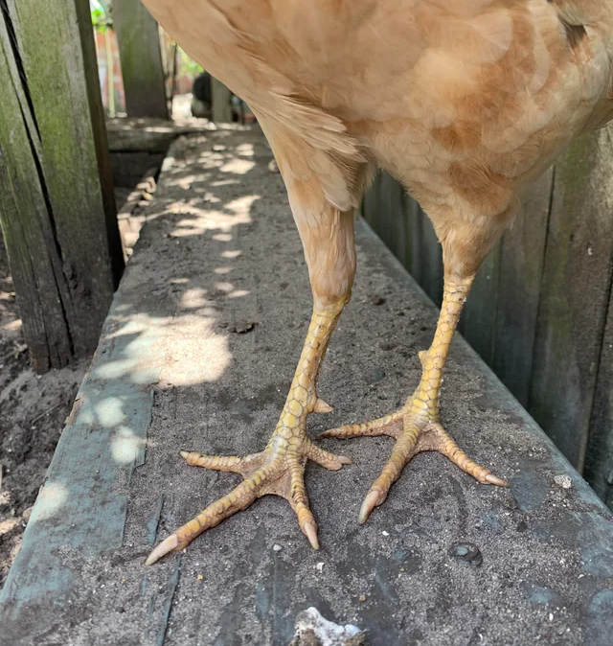

Check out my legs

